Slide 1
Delivery, Preparation, and Distribution of GEER iPADs
Procedures for Participating Providers
1.0

Slide 2
Welcome,
This slideshow will describe two procedures:
How to accept delivery of your GEER iPADS
How to prepare your iPads for distribution and assignment to a family.

Slide 3
How to Accept Delivery of your GEER iPADS

Slide 4
How to accept delivery of your GEER iPADS
A representative from the RESC Alliance will contact the primary program person reported to OEC and provide the delivery date. Your primary program person must be available on this day. Delivery will be no earlier that 8:30 and no later than 3:30. If possible, a specific time-frame will be provided.
This representative will verify that your agency has completed and signed a GEER Provider Agreement in the case of Home Visiting or ECE programs. B-3 providers will email your B-3 form to NEAT.B23@oakhillct.org upon delivery confirmation.

Slide 5
How to accept delivery of your GEER iPADS
On delivery day, the delivery person will bring the iPADs. They will be delivered pre-installed in protective cases with power cords and vinyl carry bags.
You will be asked to verify the count of the iPADs and sign a delivery confirmation. You will be provided a copy.

Slide 6
How to Prepare your iPADS for Distribution and Assign and to a Family.

Slide 7
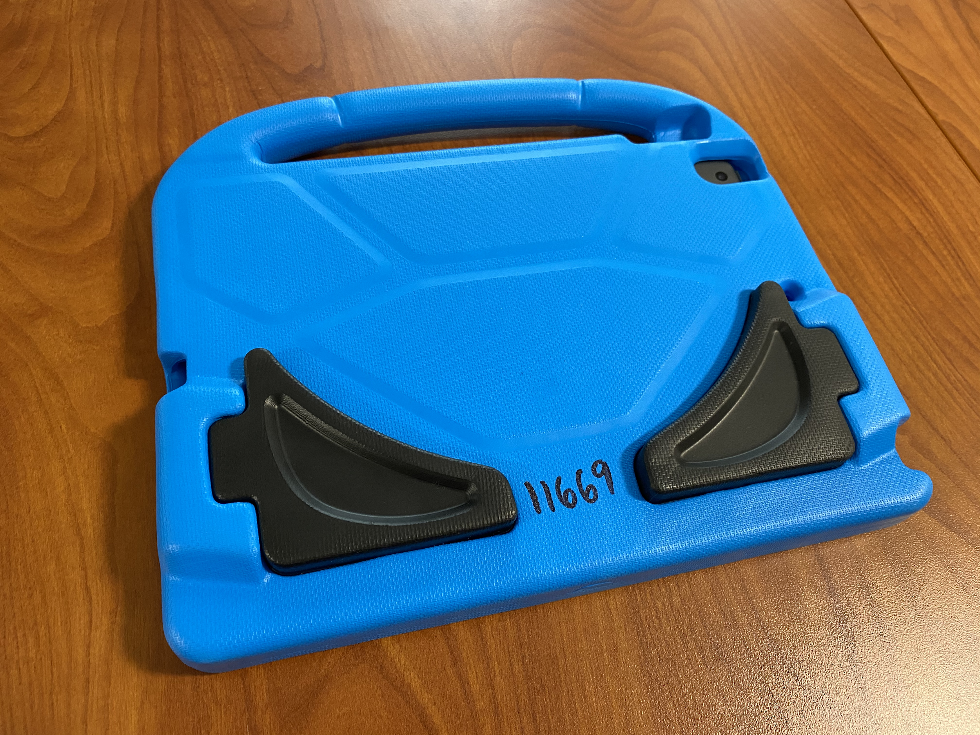
How to Prepare your GEER iPADS for Distribution
Select an iPAD and turn it on. The power button is accessible on the back. Small fingers help! The Apple Logo will appear while it starts up. Note that case colors and styles may vary.

Slide 8
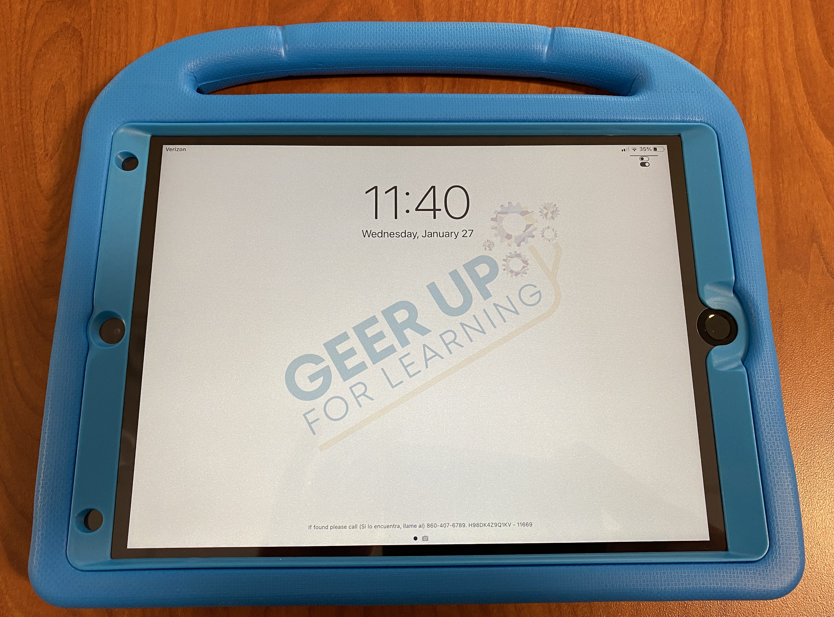
Assignment and Distribution
The iPAD should arrive charged enough to turn on. However, it may need to be charged for awhile before it will start. Charging cords were included in your delivery boxes. Setting up the charging cord is the same as with a cell phone. The charging port is on the side to the right of the handle on most cases.

Slide 9
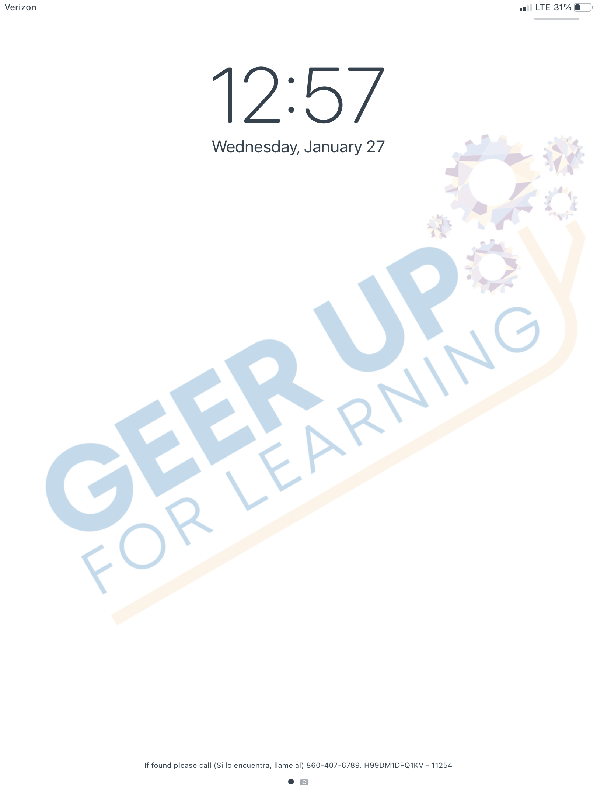
Assignment and Distribution
The iPAD will first show a blank screen with the GEER logo and the time.

Slide 10
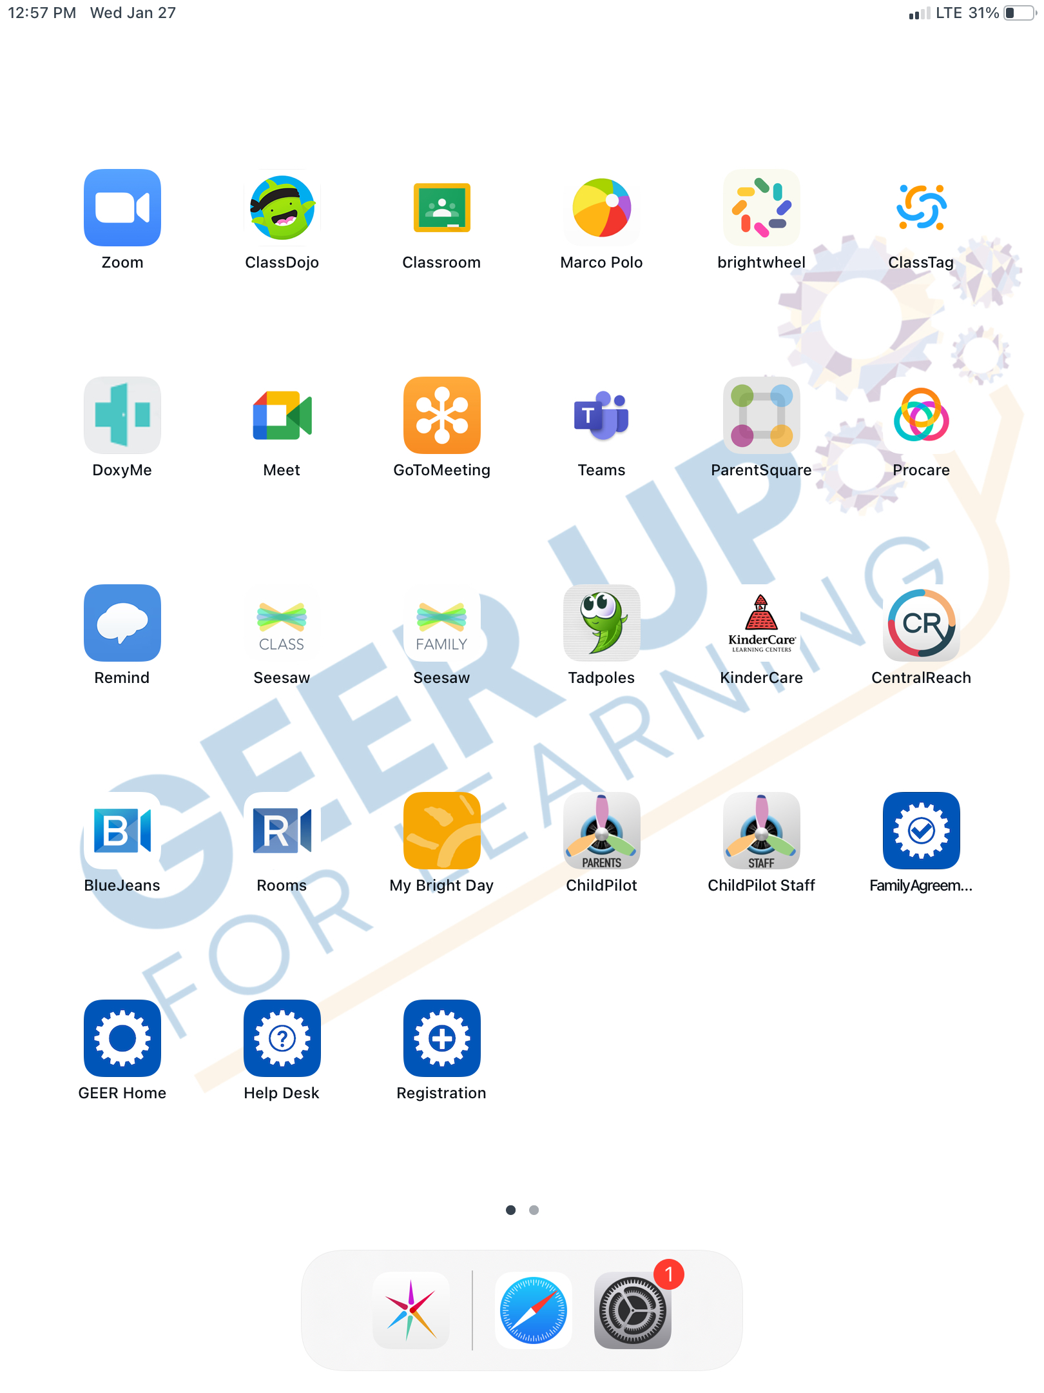
Assignment and Distribution
Click the “home” button to see all the installed apps. The apps may vary slightly from what is shown here.

Slide 11
Assignment and Distribution
Click on the “registration” app icon. It may appear in a different location on the screen. This form assigns the iPAD to a family.

Slide 12
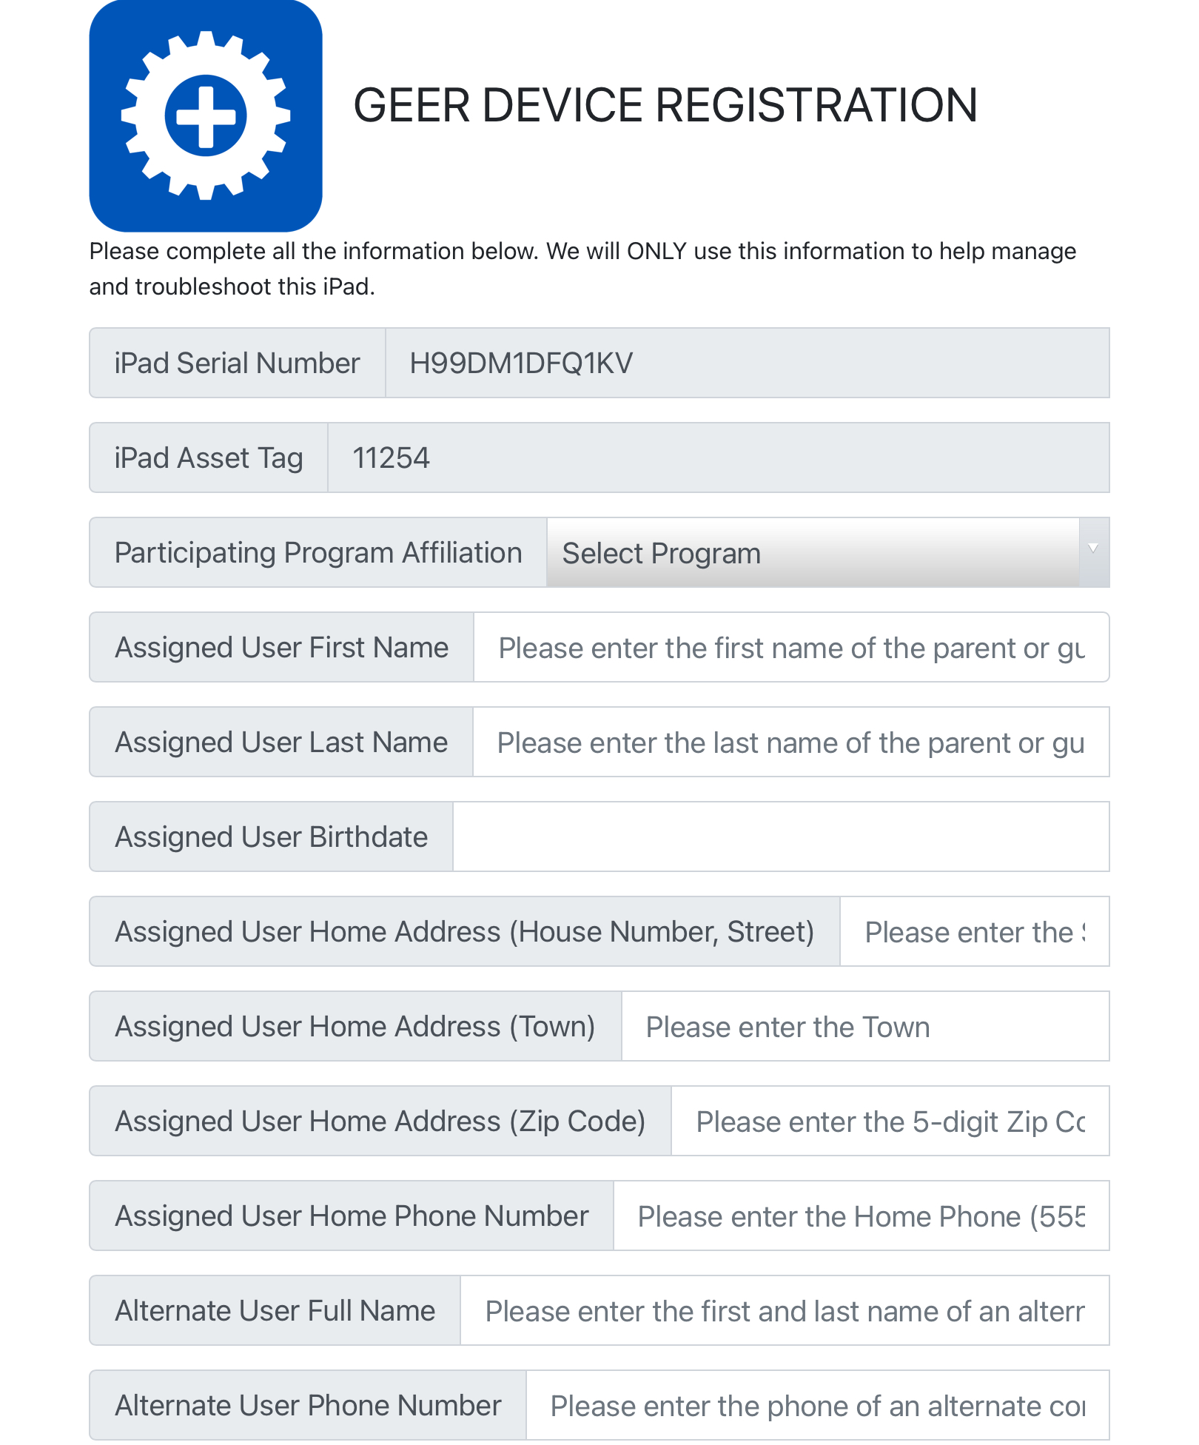
Assignment and Distribution
A form will open. Provide the requested information about the family receiving the iPAD and your agency.
Click “submit” when complete.
The registration of the iPAD is complete.

Slide 13
Assignment and Distribution
Registration Form - Things to Know
All fields must be completed.
The “User” always refers to the adult.
The “Verification Code” is always geertogo.
You must know beforehand whether the family needs cellular service or not.

Slide 14
Assignment and Distribution
At this point the GEER iPAD and charger can be placed in one of the vinyl bags that were provided. You may need to fold the handle on some case styles.
When the family has the iPAD in hand there is one final step that is required, the family needs to complete the family agreement form.

Slide 15
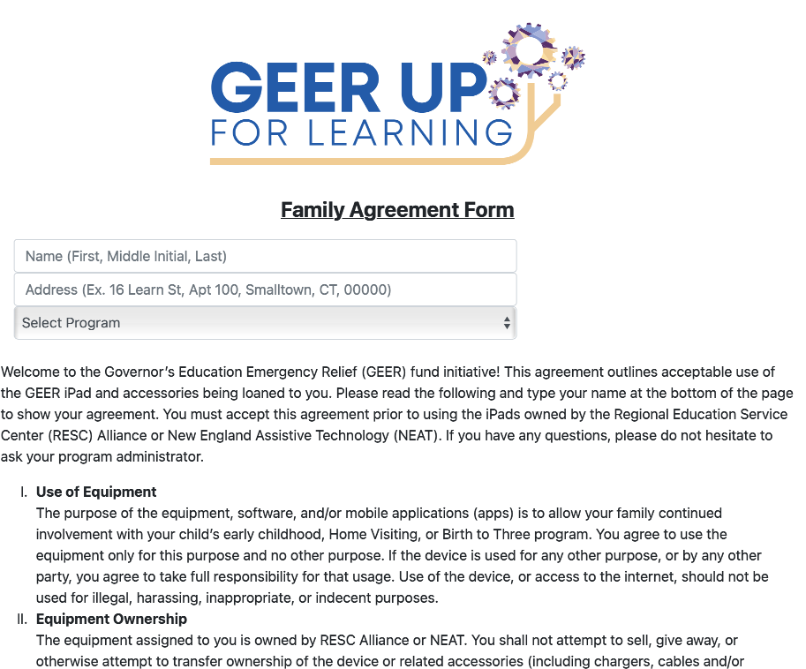
Assignment and Distribution
The Family Agreement form is available electronically on the iPAD. Icon location may vary.

Slide 16
Assignment and Distribution
Family Agreement Form - Things to Know
The family is acknowledging their decision about cell service on this form. However, it is the Registration Form that determines if cell service is discontinued.

Slide 17
Questions and Support
If you have any questions you can use the Help app on an iPAD to submit a help request.

